Slide 1
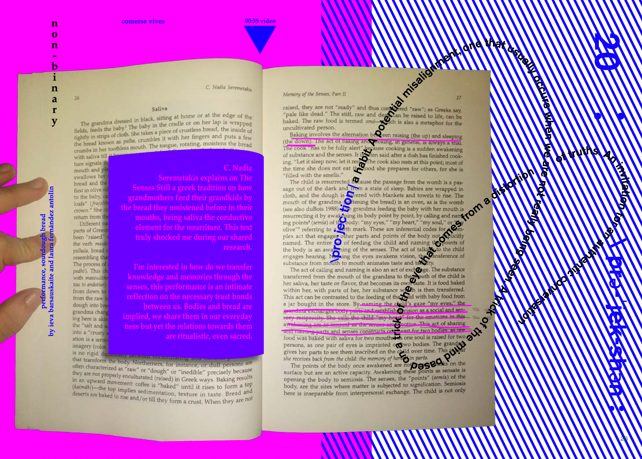
Corporeal Literacies

Slide 2
Wörtermatrix / Word Matrix (inspired by Franziska Nyffenegger und adapted)
 | Substantiv /Noun | Verb | Adjektiv / Adjective | Konjunktion* / Conjunction* | Fantasiewort / Ficticious Word
«Ich» / «I»
Künstlerische Praxis / Artistic Practice
Lehrtätigkeit / Teaching Practice
Schreibtätigkeit / Writing Practice
*Konjunktionen: aber, allein, denn, doch, nur, oder, sondern, sowohl als auch, und, als, als ob, desto, umso, wie, entweder, trotzdem, dennoch, obwohl, wohingegen, damit, um, dass....
* Conjunctions: only, but, rather, both, and, as, as if, all the more, how, either, nevertheless, nonetheless, although, even though, whereas, so that, in order to, that…..

Slide 3
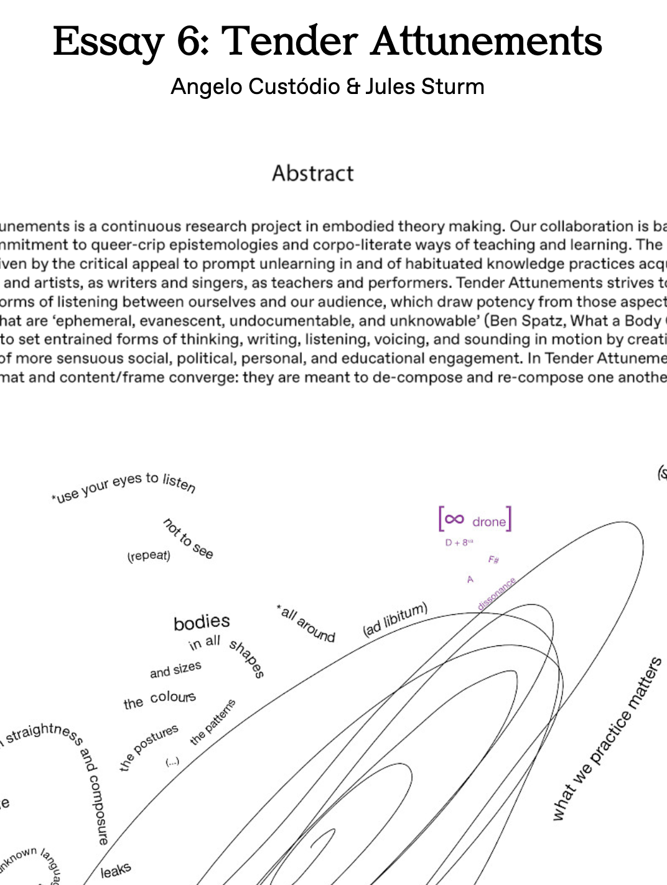
“Tender Attunements”, with Angelo Custodio

Slide 4
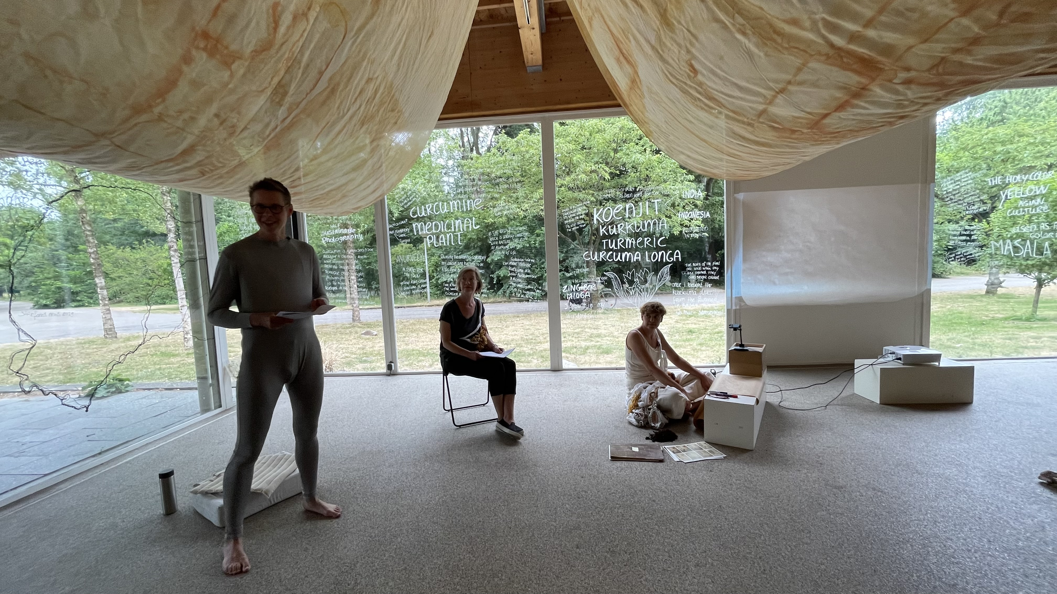
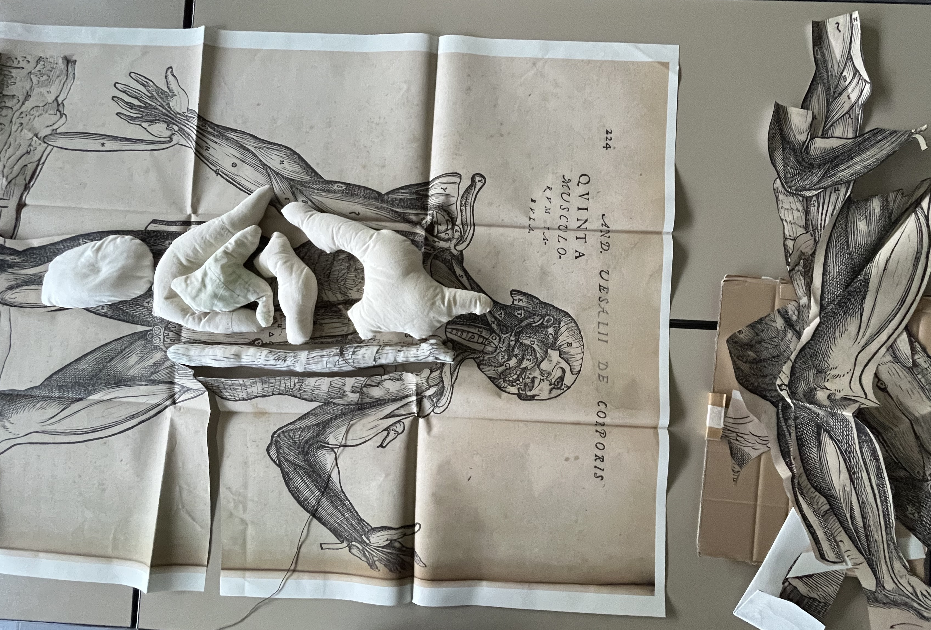
“A Living Artwork”, with Sonja Bäumel, Janina Krepart, Birgit Nemec

Slide 5
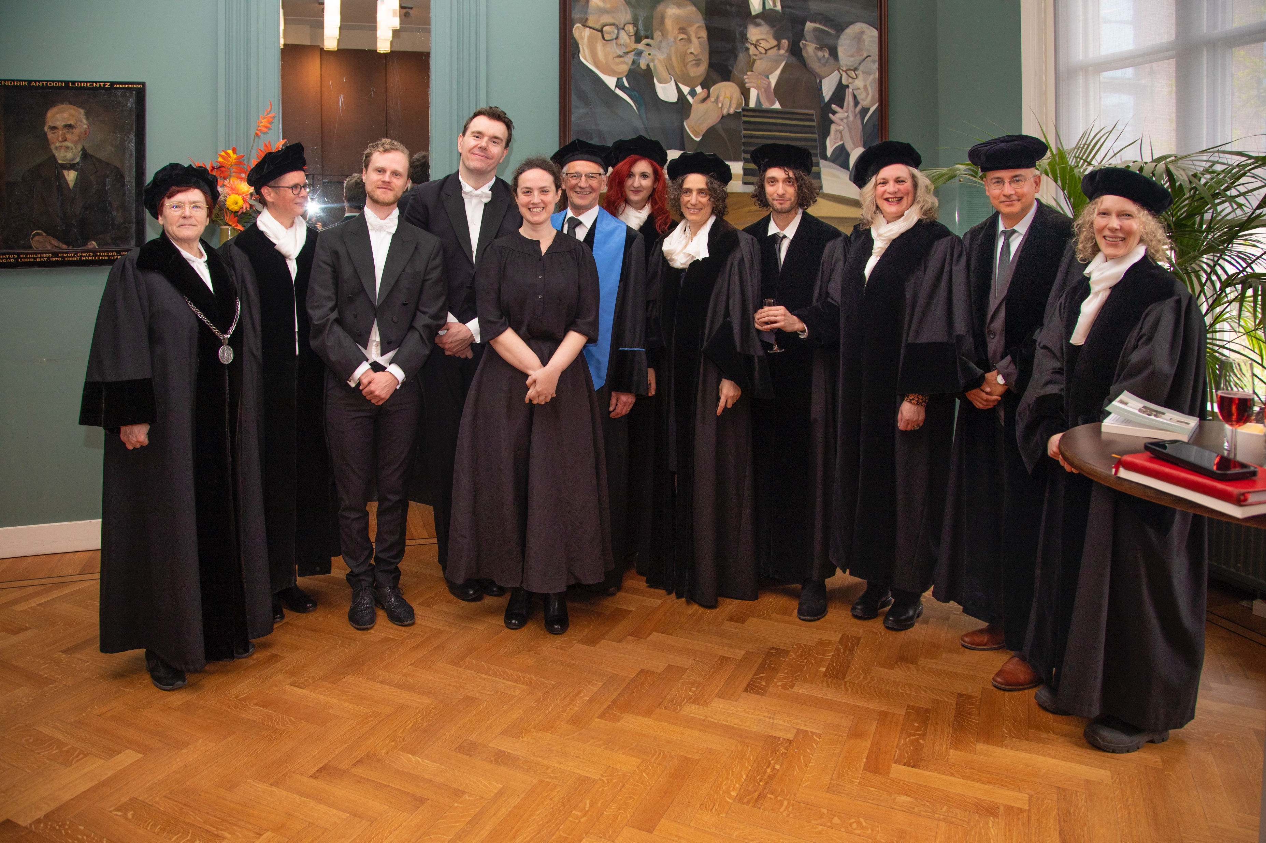
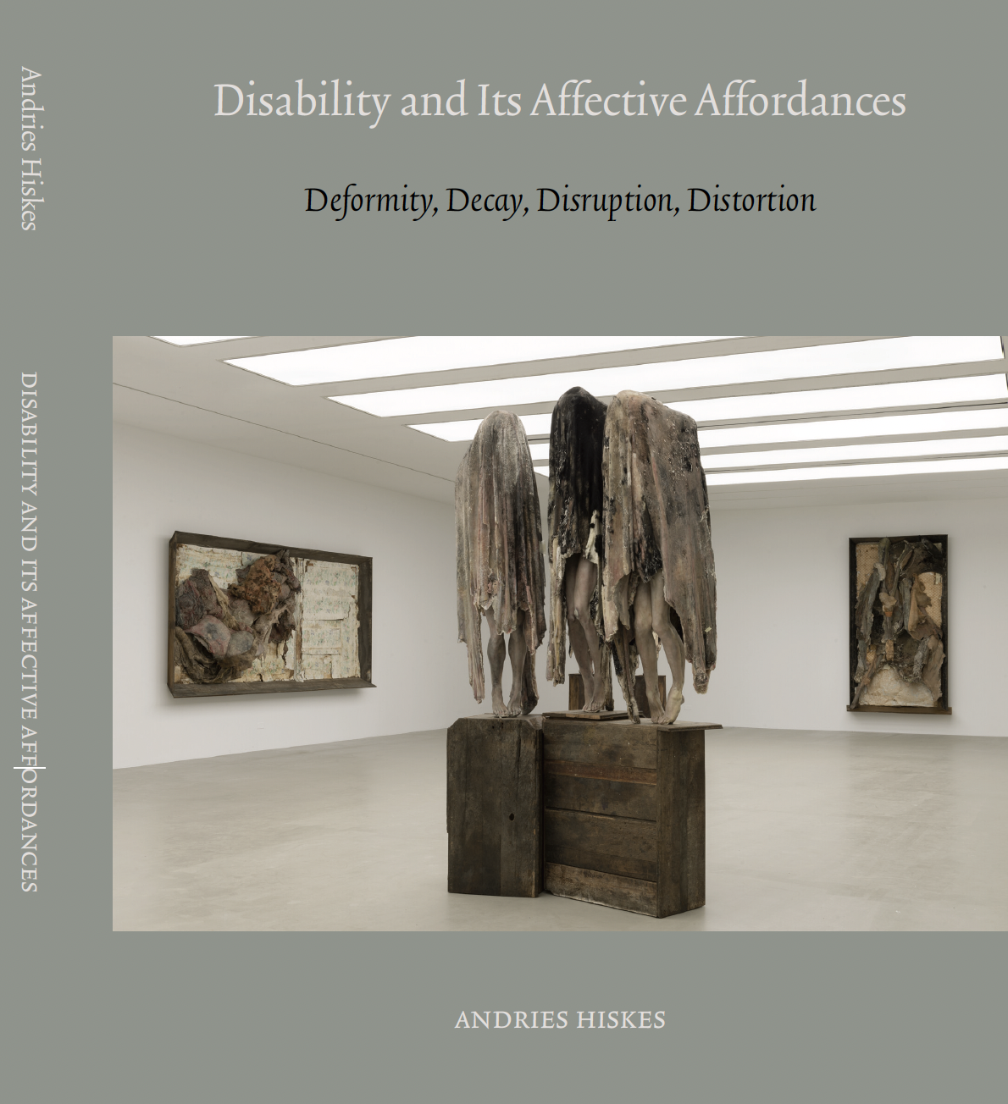
Academic Tourism…. Writing, PhD supervision, lecturing

Slide 6
Visual Literacy
„Visuelle literacy soll uns in die Lage versetzen, an der visuellen Kultur als Rezipient:innen oder Produzent:innen aktiv teilzunehmen. Sie befähigt dazu, die visuelle Kulturalisierung aktiv mitzubestimmen, indem wir auf die visuellen Angebote emotional und kognitiv reagieren, sie geniessen oder sie verabscheuen, sie aber auch kritisch hinterfragen - seien es nun massenmediale, populäre oder künstlerische Bilder. Dazu müssen die in ihnen angelegten Muster, Verhaltensregeln, Blicklenkungen, die ihrerseits zur Konstruktion, Identifikation und Kontrolle von Subjekten und Kollektiven beitragen, gelesen oder durchschaut werden. Es geht bei der Visual literacy also nicht nur um das Kennen und Beherrschen von visuellen Techniken und Medien, sondern auch um das Bewusstsein von psychischen und kognitiven Einflüssen von Bildern. Nur wer eine kritische "Sehverstehenskompetenz" (Visual literacy) besitzt, kann sich in der Bilderschwemme, die von der Werbeanzeige bis zum Computerspiel reicht, behaupten. Es geht dabei darum, die offensichtlichen und geheimen Kommunikationsstrategien von Bildern zu erkennen, explizite und implizite Botschaften aufzunehmen und den Wirklichkeits- oder Wahrheitsanspruch von Bildern zu überprüfen. Visual Literacy führt in einem zweiten Schritt zum Bedürfnis, selbst vermehrt in verschiedenen Situationen Bilder zu verwenden, mit ihnen zu kommunizieren und Geschichten zu erzählen.“
(https://www.zhdk.ch/forschungsprojekt/bilder-verstehen-zur-visual-literacy-in-der-schweiz-am-beispiel-der-fotografie-im-musealen-kontext-426452)

Slide 7
Visual Literacy
"Visual literacy aims to enable us to actively participate in visual culture as recipients or producers/makers. It empowers us to actively influence visual ‘culturalization‘ by emotionally and cognitively responding to visual offerings, enjoying or disliking them, but also critically questioning them - whether they are mass media, popular, or artistic images. To do this, the patterns, behavioral norms, and visual cues inherent in them, which in turn contribute to the construction, identification, and control of subjects and collectives, must be read or deciphered. Visual literacy is not only about knowing and mastering visual techniques and media, but also about being aware of the psychological and cognitive influences of images. Only those who possess a critical "visual understanding or competence" (visual literacy) can assert themselves in the flood of images, ranging from advertisements to computer games. It is about recognizing the obvious and hidden communication strategies of images, absorbing explicit and implicit messages, and examining the reality or truth claims of images. Visual literacy leads, in a second step, to the need to increasingly use images in various situations, communicate with them, and tell stories.“ (translated by ChatGPT, April 2024)
(https://www.zhdk.ch/forschungsprojekt/bilder-verstehen-zur-visual-literacy-in-der-schweiz-am-beispiel-der-fotografie-im-musealen-kontext-426452)

Slide 8
Corpoliteracy
“Once activated, corpoliteracy marks the struggle to rely on the ‘corpo’ or body movements as a reliable informant beside the more formal components of reading and writing – knowing or ‘literacy’. In this scheme, narrating and writing are on equal footing as a corporeal phenomenon for recounting history, making community and transcending the boundaries of language. The body is as much a witness capable of providing testimony – through movement and dance – much like written, spoken, eyewitness or earwitness accounts. The term corpoliteracy was coined by curator and polymath Bonaventure Soh Bejeng Ndikung and speaks to a consciousness of mind and body rhythm-equity.” (Nick Aikens & Yolande Zola Zoli van der Heide, In: On Corpoliteracy)

Slide 9
Corpoliteracy – corporeal literacy
“The emphasis on the corporeal dimensions of perception distinguishes corporeal literacy from corpoliteracy – proposed by Bonaventure Soh Bejeng Ndikung in Volume 3 of this series, “Counter_Readings of the Body” – although the term likewise acknowledges the body as a site and "a medium of learning, a structure or organ that acquires, stores, and disseminates knowledge.” (Ndikung)
Going further, corporeal literacy as a conceptual tool sheds light on how the sedimented effects of bodily practices co-shape the human mind and the ways in which we perceive and make sense. Mind here does not refer to something existing separately from the body. Rather, what we conceive of as "mind" emerges from the interaction of our bodies with the world we encounter-including as part of our coevolution with technology – that is, the bodymind.” (Bleeker, 29)

Slide 10
Literacy Disembodied?
“Popular and specialist notions of literacy alike conceive of the human body as physically and socially detached from literate practice. Though literacy cannot be taught or practiced without bodies, bodies have rarely been considered as a relevant dimension of literacy theory. …
A mark of literate competence is skill in disguising or erasing the contribution of one's own body to the process of textual production and practice. A mark of literate power is the freedom to command other bodies for textual display or concealment, as the occasion warrants. In this paper we will use the term embodied literacy to refer to the set of bodily routines associated with text in the service of social stratification. … Literacy we conceive to be a set of variable and culturally specific techniques for organizing, expressing, and performing social relationships around the interaction of texts and bodies.” (Carolyn Marvin, 129)

Slide 11
Socio-political dimensions of literacy’s
disembodied practice
“Efforts to eliminate evidence of the body's contribution to textual production are efforts to minimize the visibility of the body in literate practice and to reject certain classes of socially despised bodies…. In the economy of signs that regulates the relationship between body and text, the body is depicted as struggling against text. Those who are literate struggle with their own bodies, or with the bodies of those whose illiteracy is taken as a sign that they are in need of control.” (Marvin, 131)

Slide 12
“At its most formal and scholarly, prose has traditionally been distinguished from speech, or language in which bodily agency is undeniable, by displaying no trace of dialect, pitch, gender,· none of the vocal hesitancies that characterize speech and, above all, no trace of the physical agony of composing it. Well-formed prose should contain no evidence of sleepless nights, binged food, filled ashtrays, or hair ruffled in the service of arranging resistant letters on the page.· While the .mind is actively engaged in reading and writing, the body is bullied, unnaturally, into quiescence. It rebels and behaves badly…. ” (Marvin, 131)
“Literate acts aim at dissociating mind from body. To practice literacy is, at the very least, to disguise and repudiate the body. At most, it is to damage or destroy it physically, morally, and emotionally.” (Marvin, 132)

Slide 13
Corporeal Literacy
„Anders als ‚Medien‘ in Medienkompetenz, bezeichnet ‚körperlich‘ in körperlicher Literalität nicht eine Kategorie von Information oder einen Aspekt von gelesenen Objekten, sondern verweist auf die körperliche Dimension von Wahrnehmung und Sinngebung und darauf, wie diese Dimensionen durch praktisches Handeln, durch den Angebotscharakter von Werkzeugen und Technologien, durch die Umgebungen, auf die Menschen sich einlassen, und gleichfalls durch in Fleisch und Blut übergegangene Gewohnheiten geprägt werden.“ (Bleeker, 31)

Slide 14
Corporeal Literacy
„Unlike ‚media‘ in media literacy, ‚corporeal‘ in corporeal literacy does not denote a class of information or an aspect of objects being read but rather refers to the corporeal dimensions of perception and sense making and to how these corporeal dimensions are informed by practices of doing, by the affordances of tools and technologies, by the environments with which humans engage, as well as by habits and practices they have incorporated.“ (Bleeker, 28-29)

Slide 15
„So verstanden, beschreibt die Literalität eine situierte Grundbedingung, die daraus resultiert, wie die aus der Benutzung von Schrift und Druck erworbene Fähigkeiten, sobald sie verkörpert sind, die Art und Weise des Verstehens beeinflussen, nicht nur des Verstehens von Sprache, sondern auch von anderen Dingen: der Welt, des menschlichen „Selbst“ in all seinen Formen. Auf ähnliche Weise geht es bei der körperlichen Literalität nicht darum, wie Sprache Körper beeinflusst oder wie Körper in unsere Sinngewinnung aus Sprache involviert sind. Bei ihr geht es darum, was das Medium von Schrift und Druck (und andere Technologien ebenso) mit Körpern macht, und umgekehrt. ... Und wie vermitteln zugleich Technologien die Entwicklung neuer kognitiver Wahrnehmungsfähigkeiten und, im erweiterten Sinn, neue Denk- und Vorstellungsweisen?“ (Bleeker 35-36)

Slide 16
„Literacy thus understood describes a situated condition that results from how, once incorporated, those skills acquired from the use of writing and print affect modes of understanding, not only of language but also of other things: of the world, of human ‚selves‘. Similarly, corporeal literacy is not about how language affects bodies or how bodies are involved in how we make sense of language. It is about what the medium of writing and print, as well as other technologies, do to bodies and vice versa. How do technologies afford modes of engaging with knowledge that respond to the bodies‘ potential for perception and understanding? At the same time, how do technologies mediate the development of new cognitive perceptual skills and, by extension, new modes of thinking and imagining?“ (Bleeker 32)

Slide 17
23. Mai 2024 Reading/Listening
“Writing is a relationship with the self, after all. It's a ritual of tuning in and listening to the language inside of us. Those words are power. Power to make sense of ourselves, by ourselves, independent of the system of white supremacy that tells people of color that we have no dignity, no history, no art, no voice.(…) We dare to tune in and listen to our own words, in our own tongues, and translate them onto the page with our own fists.”
(Felicia Rose Chavez: The Anti-Racist Writing Workshop. How to Decolonize the Creative Classroom, p. 98)

Slide 18
Autotheoretisches Schreiben
“My whole problem with theoretical structures has to do with their displacement of physicality, as if there is a seepage or a toxicity from the experience of the body that is going to invade language and invalidate theory.” (Carolee Schneemann, Imaging Her Erotics)
“As a way of describing an artist’s or writer’s way of working, autotheory seems a particularly appropriate term for works that exceed existing genre categories and disciplinary bounds, that flourish in the liminal spaces between categories, that reveal the entanglement of research and creation, and that fuse seemingly disparate modes to fresh effects.” (Lauren Fournier, Autotheory as Feminist Practice in Art, Writing, and Criticism)

Slide 19
I don’t make a big distinction between writing about “myself” and writing about “larger issues.” (Maybe I’m Emersonian in that way, or just feminist.) - Maggie Nelson, in conversation with Micah McCrary
The term “autotheory” emerged in the early part of the twenty-first century to describe works of literature, writing, and criticism that integrate autobiography with theory and philosophy in ways that are direct and selfaware. The “memoir with footnotes” would be one example. Most simply, the term refers to the integration of theory and philosophy with autobiography, the body, and other so-called personal and explicitly subjective modes. It is a term that describes a self-conscious way of engaging with theory—as a discourse, frame, or mode of thinking and practice—alongside lived experience and subjective embodiment, something very much in the Zeitgeist of cultural production today— especially in feminist, queer, and BIPOC—Black, Indigenous, and people of color—spaces that live on the edges of art and academia. (Lauren Fournier, Autotheory as Feminist Practice in Art, Writing, and Criticism)

Slide 20
“Den Begriff „Autotheorie“ hat Paul B. Preciado geprägt. Im ersten Satz von „Testo Junkie“ heißt es, bei dem Buch handele es sich nicht um Autofiktion. Was stattdessen vorlegt werde, sei eine „somapolitische Theorie des Selbst, oder eine Selbsttheorie“ – “una autoteoria“. Maggie Nelson greift diese Bezeichnung in „Argonauten“ auf. Auch ihre Schreibweise will nicht nur eigene Erfahrungen erzählen, sondern sie mithilfe von Theorien transformieren. Damit zieht Theorie als Werdensformel in die Literatur ein. Sie ist nicht nur Teil der Schreibszene und der literarischen Fiktion, sondern auch des erschriebenden Selbstverhältnisses. Im Unterschied zu identitätsgetriebenen Autobiographien verläuft das autotheoretische Schreiben dabei auffallend häufig über Desubjektivierungen. Statt das eigene Selbst narzisstisch zu stabilisieren, werden dominante Subjektivierungsweisen geschwächt. Dieses Erproben neuer künstlerisch-wissenschaftlicher Schreibformen findet einen Nachhall nicht nur in der Theorie selbst, sondern auch in der künstlerischen Forschung.”
(Hanna Engelmeier; https://www.kulturwissenschaften.de/veranstaltung/autotheorie-kunst-schreiben-und-die-bruechigkeit-des-selbst/)

Slide 21
Kulturanalytische ”Techniken”
Close-Reading
Art-Writing
Image-Thinking
Working with Concepts
….

Slide 22
Art-Writing Mieke Bal
art-writing is also about looking or about how we look at art and what the art-work does to our looking.
“art-writing must sever the all-too-tight connections between disciplinary dogmas, such as those relating to influence, context, iconography, and historical lineage. … Art-writing ought to put the art first.” (Mieke Bal, Spider)
books also produce images
“Writing about art is not a substitute for the art. Rather than standing in for the visual objects, texts about them ought … to lead the reader (back) to those objects. Instead of being a substitute, a good text about art is a supplement to it.” (Bal, Spider)
“…so little is said about what we see and what kind of seeing is involved.”
We should ask: “what the work is, means and does in the present time of viewing.”
“The primary lack in traditional art-writing is the absence of a close engagement with the work itself. Close readings of visual works are perhaps the most exciting ones.”
Necessity: “a principle of openness toward the social as well as the emotional, cognitive, and affective processes that we call … aesthetic.”

Slide 23
Image-Thinking Mieke Bal
how to think with images
using visual language and thought-images (Denkbilder)
Messy form of thinking: combining material and practical changes, confusion of langugages, trans-mediation/intermediality (audio-visualization of a literary text) – enables and activates viewers to construct their own story and connect it to what they see around them.

Slide 24
Close-Reading Frans-Willem Korsten
“I would like to share (the) contention that close reading cannot be anything other than a materialist kind of reading, that is to say a form of reading in which the mater indicates a principally gendered body that does not so much disseminate but brings forth. As for close reading, there is no possibility of escaping material concreteness and by implication, sociocultural differences or gendered ones. Close reading can never be, in whatever way, objective or universal. As the word ‘close’ suggests, such a kind of reading is spatially particular, intrinsically sensitive, sensible, and principally embodied.” (Frans-Willem Korsten, “Close-Reading”, 444)

Slide 25
De/composition Robert McRuer
Beispiele:
- “Tender Attunements”, Angelo Custodio & Jules Sturm, 2023:
https://extraintra.nl/article/towards-new-schools/essay-6-tender-attunements/
“Corpolegible”, Joy Mariama Smith (In: On Corporliteracy)
“Choreography of a Collective Imaginary”, Coopertiva Cráter Invertido (In: On Corpoliteracy)

Slide 26
Visual and verbal/linguistic reading practices
Olave Nduwanje
(2019): Performance at Reading Bodies! The New Alphabet School, HKW Berlin.
https://www.hkw.de/en/app/mediathek/audio/75567

Slide 27
“Have you learned to fear a knowing look? Does a confident gaze terrify you too? Do you also fear the violence of eyes that read?” (Olave Nduwanje, Do Not Read This Body!)
“Das verkörperte Sprechen der Dolmetscherin verzerrt für Nduwanjes hörendes Publikum die Verbindung von Gesagtem zu Sichtbarem, von Gehörtem zu Gesehenem: Sehen, Hören, Sprechen und Empfinden verzweigen sich, überlagern sich und widersprechen sich, da sie nicht einem einzelnen lesbaren Körper zugeordnet werden können. Gebärden (signs) und Gesten (gestures) verkörpern zwei Kommunikationsformen, die sich unterschiedlich zu sprachlichen Zeichensystemen (Gebärdensprache, gesprochene Sprache) und ihren Zuschreibungen und Bedeutungen verhalten.” (Sturm, “Gesten der Verkörperung”, 2022: 62)

Slide 28
“Have you learned to fear a knowing look? Does a confident gaze terrify you too? Do you also fear the violence of eyes that read?” (Olave Nduwanje, Do Not Read This Body!)
“The embodied speech of the interpreter distorts, for Nduwanje’s hearing audience, the connection between the spoken and the visible, between the heard and the seen: seeing, hearing, speaking, and feeling branch out, overlap, and contradict each other, as they cannot be assigned to a single readable body. Gestures and signs embody two forms of communication that relate differently to linguistic systems (sign language, spoken language) and their attributions and meanings." (Sturm, "Gestures of Embodiment", 2022: 62) – translated by ChatGPT, April 2024

Slide 29
“I can feel your scanning eyes, your knowing eyes, your pretentious eyes, your judgmental eyes. I can feel them on my skin, on the curve of my lips, on the edges of my frown, on the heights of my cheekbones.
I can feel your eyes. They reach for the shape of my knuckles, the contour of my cock in my squirt. I can feel them. Your eyes. They are hungry.
They press on my soft belly, wondering what I eat,
They press on my hard skull, calculating what I am thinking,
They press on my beating heart, guessing what I am feeling.”
You do see that I am Black. You see it, I know it and you know it. The effort you do to not acknowledge my Blackness is violent. It is self-serving, it is inexcusable. It is no cause for congratulations, for applause. ... It is lazy, violent, and untruthful.”

Slide 30
I rather you would just look. Just look! Bear witness, don’t claim me! Pick a place beside me, and let me do the seeing. I look from the inside out. It is cozy and dark in here. Inside here, it is also lonely and scary. … Just look, and when you can’t bear to look anymore, kiss me, be with me inside.” (O. Nduwanje)

Slide 31
“Ich vermute, dass es mich auch darum ins Schreiben zog, weil das Schreiben eine einzige Wellenlinie ist, eine von weither kommende Woge, die lange vor mir begonnen hat und lange nach mir weiterfliessen wird. Weil das Element der Sprache das Flüssige ist. Das Träge, das Tiefe, Latente, das Tragende, Mitreissende, Anbrandende, das Ertränkende, Speicherne, Leben Gebende, Unerschöpfliche, Spiegelnde, Monster Beherbergende, Auflösende. Weil ich immer ein Wasser war, mein Körper immer spürte, wie sehr er ein Fliessen ist, ein In-Bewegung-Sein.” (Kim de l’Horizon, Blutbuch, 2022)

Slide 32
“I suspect that part of what drew me to writing was that writing is a single wave line, a wave coming from afar that began long before me and will continue long after me. Because the element of language is fluid. The sluggish, the deep,the latent, the supportive, the captivating, the overwhelming, the drowning, the recording/saving, life-giving, inexhaustible, reflective, monster-harboring, dissolving. Because I have always been water, my body always felt strongly that it is a flow, a state of movement.” (Kim de l’Horizon, Blutbuch, 2022); translated by ChatGPT, April 2024

Slide 33
Joy Mariama Smith: Corpolegible
“Is the body a source from which we can understand things other than the mind? And what is the body learning? Their contribution includes a series of videos where we encounter movements and exercises, some of which unfold across the spaces of the Van Abbemuseum, in which the body becomes the site to simultaneously evoke and resist legibility. Developed with a number of collaborators Mariama Smith’s pages are conceived as a series of ‘glosses’, prompting the reader to twist, turn and contort, or even read with others.” (In: On Corpoliteracy, 5)

Slide 34
Joy Mariama Smith, “Corpolegible”, In: On Corpoliteracy. Van Abbemuseum, 2022: 19-29

Slide 36
Underbelly Resonances Angelo Custodio/Jules Sturm

Slide 37
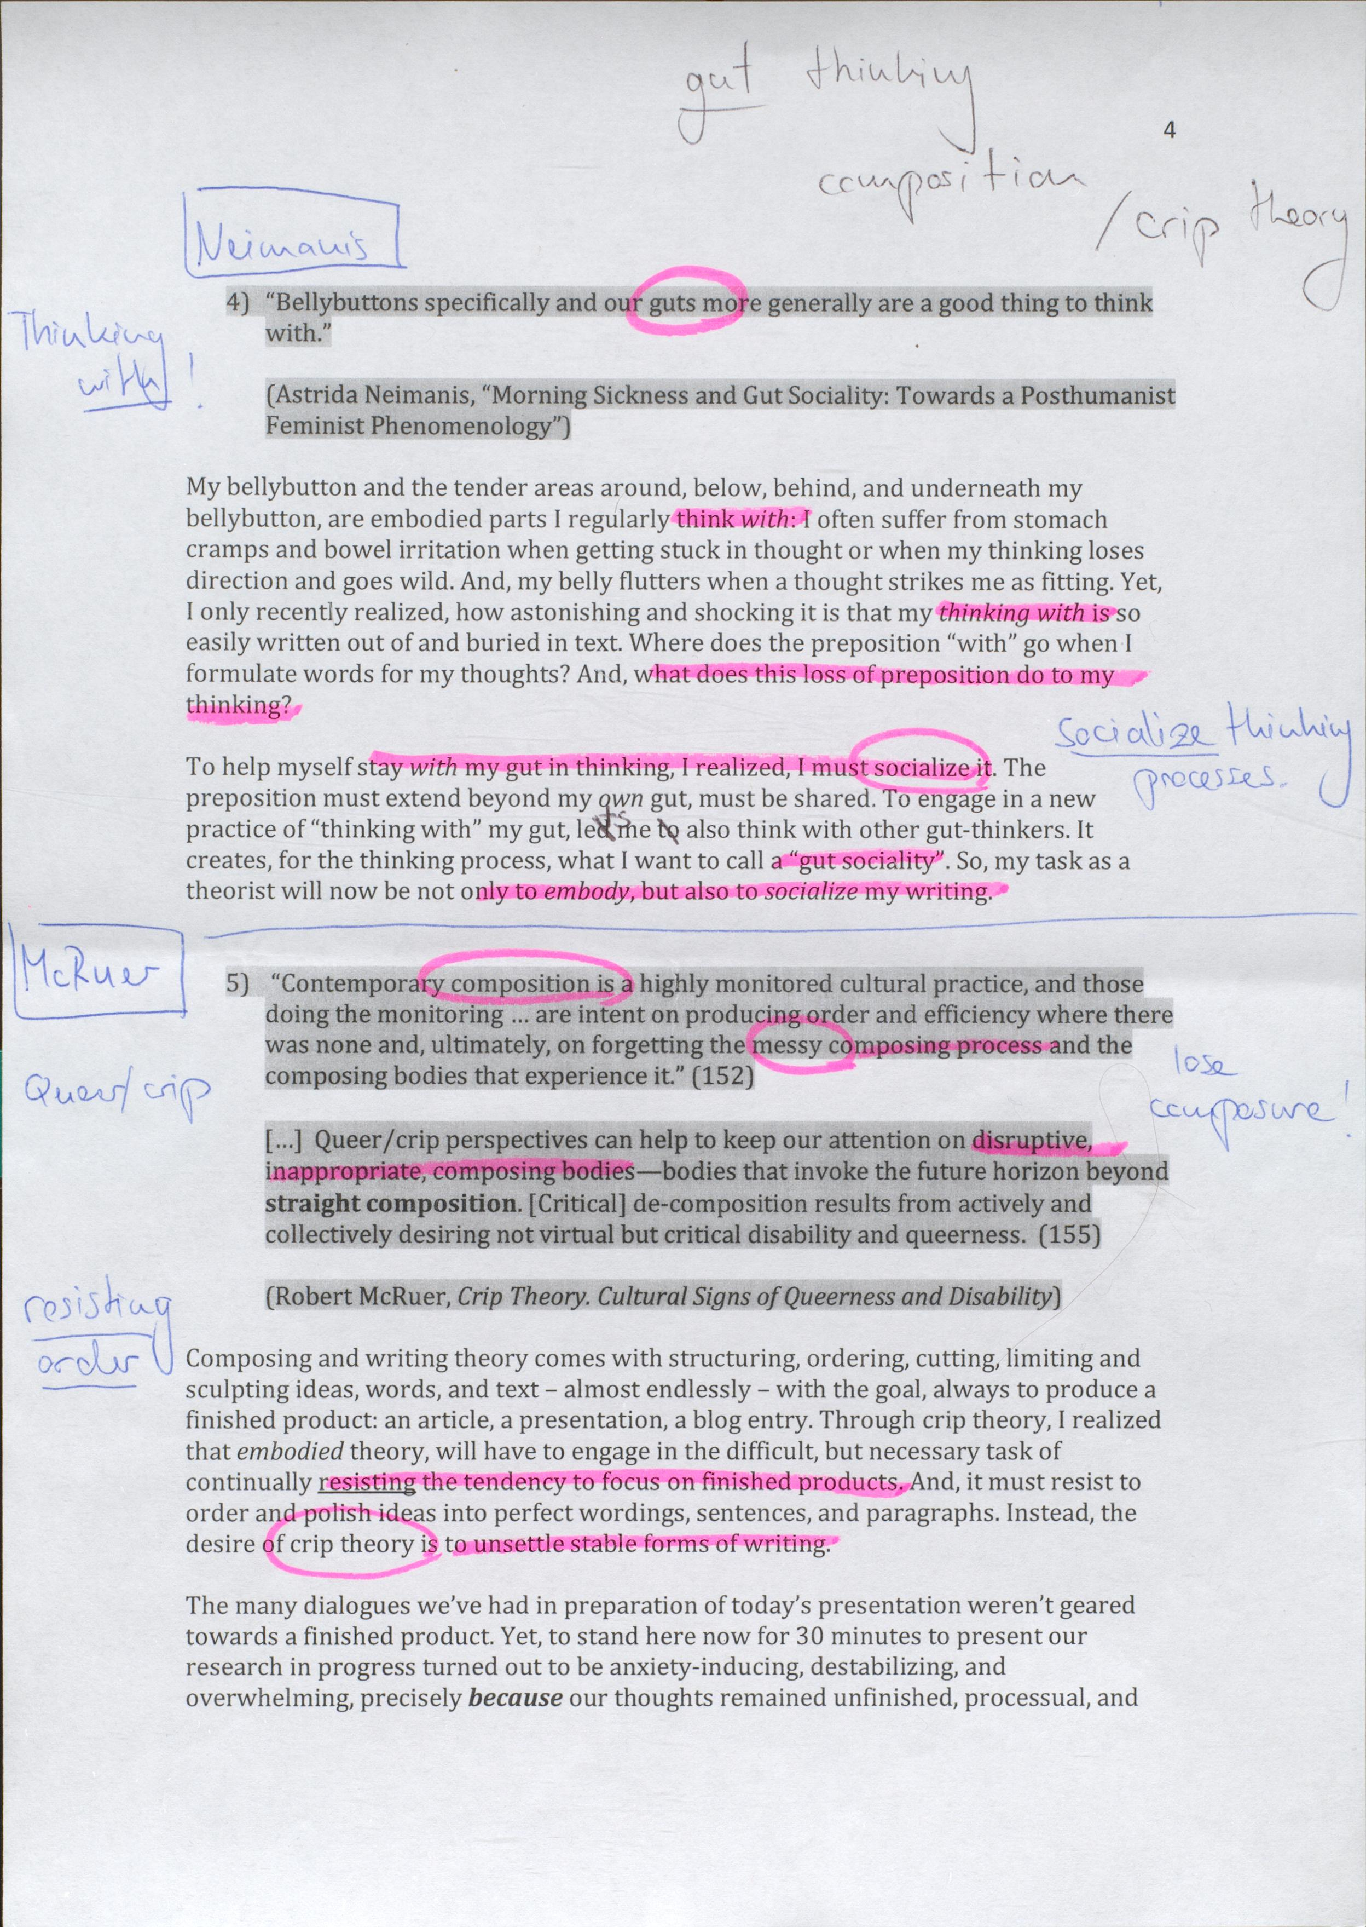

Slide 38
McRuer Crip Theory
“Writing is the making of an order and the blank surface is that space or servant that bears the order. Typically, writing catches the eye, but the surface that receives the writing does not. In this sense, writing contains the stronger presence, and the surface that receives the writing is defined by that presence. The surface, then, is an ordered, limited space cleared of obstacles and ready to be acted upon by an ordering agent wielding a highly routinized tool.” (Ralph Cintron in McRuer 147)

Slide 39
“How, then, to acknowledge and affirm the experiences we draw from multiple academic and nonacademic communities where composing (in all senses of the word) is clearly an unruly, disorderly cultural practice? Can composition theory work against the simplistic formulation of that which is proper, orderly, and harmonious? If, as the dictionary definition suggests, composing is somehow connected to labor, is it possible to resist the impulse to focus on finished products (the highly routinized, “well-made” essay; the sonnet sequence; the supposedly secure masculine or heterosexual identity) and to keep that labor in mind as we inquire into what composition means and into what it might mean in the future? … What vital role might contemporary composition have in the production of producers? What would happen if, true to our experiences in and out of the classroom, we continually attempted to reconceive composing as that which produced agitation—to reconceive it, paradoxically, as what it is? In what ways might that agitation be generative? (McRuer, 147-8)

Slide 40
“Although it is by no means universally acknowledged (to judge by how
little or how slowly pedagogical and institutional practices have
changed), there is nonetheless widespread critical recognition at this
point that composition, as it is currently conceptualized and taught in
most U.S. colleges and universities, serves a corporate model of efficiency
and flexibility. What we might call the current “corpo-reality” of composition
guarantees that instruction is often streamlined across dozens of
classes at a given institution, with standardized texts (handbooks, guides
to the writing and research process, essay collections) required or strongly
encouraged (either by campus or departmental administrators or by publishing
houses). Inside and outside the university, corporate elites demand
that composition courses focus on demonstrable professional-managerial
skills rather than critical thought—or, more insidiously, “critical
thought” is reconceptualized through a skills-based model ultimately
grounded in measurement and marketability, or measurement for marketability.” (McRuer, 148)

Slide 41
Coopertiva Cráter Invertido: “Choreography of a Collective Imaginary”, In: On Corpoliteracy

Slide 42
Coopertiva Cráter Invertido: “Choreography of a Collective Imaginary”, In: On Corpoliteracy

Slide 43
Reading/Writing Images
David, Michelangelo Buonarroti (1501-1504)

Slide 44
Into One-another III, to P.P.P.
Berlinde de Bruyckere (2010)

Slide 45
Wörtermatrix, Nr. 2 (inspiriert von Franziska Nyffenegger und adaptiert)
 | Körperteil | Aktion/Aktivität | Sinneswahrnehmung | Material/Medium | Fantasie/Bild/ Imagination
«Ich»
Künstlerische Praxis
Lehr-/Lerntätigkeit
Schreibtätigkeit

Slide 46
Wörtermatrix Nr. 3 (inspiriert von Franziska Nyffenegger und adaptiert)
 | Substantiv | Verb | Adjektiv | Konjunktion* | Fantasiewort
«Ich» / Persönliches
Inhalte / Themen
Aktivitäten
«Wir» / Soziales
*Konjunktionen: aber, allein, denn, doch, nur, oder, sondern, sowohl als auch, und, als, als ob, desto, umso, wie, entweder, trotzdem, dennoch, obwohl, wohingegen, damit, um, dass....

